Slide 1
High Instance CPU and OpenMP
Christopher Booth 6381890
Chenming Yu 8016274

Slide 2
Multiprocessing in Python
GIL stops multi-threading but using multiple processes works.
Python can create managed memory that can collect all the data from the processes
The shared variables work very slowly

Slide 3
We used specialized queries to ensure we were pulling unique tweets with every process, for this reason we did not use a process pool but instead just individually defined each process

Slide 4
Cython and multi-threading
-Cython and Openmp is suited for programs that benefit greatly from python’s simplicity but also need to manage large data sets occasionally.
-Twitter’s API essentially makes a large enough data set impossible.
-add small amounts of overhead to the program that can outweigh its benefit with small datasets.

Slide 5
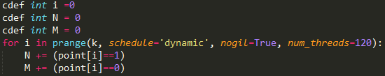
Using OpenMP through cython is fairly simply because of all the legwork to get it to work allows a simpler implementation. Original OpenMP declarations can also be defined but we decided for our needs that was unnecessary. As shown below we parallelized this simple loop in python essentially by making our code produce the needed C defined variable and then using prange instead of range in the loop.

Slide 6
Parallelizing the machine learning of Textblob
This proved to be an issue in that textblob itself is GIL locked.
One option was to do text analysis within each process during the multiprocessing part of the program.
Best option was exploring the use of spaCy

Slide 7
spaCy
Does natural language processing just like textblob but is programmed in Cython
spaCy is not GIL looked but does not have a module for sentiment analysis
Time constraints stop us from exploring the use of keras to design a sentiment analyzer for spaCy

Slide 8
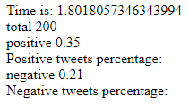
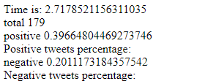

Time Improvements
Tests run with pulling 200 tweets to avoid API limiting
Parallel: Serial:
In parallel the tweets were received much faster but processing was substantially longer because of the overhead of OpenMP and the tiny dataset

Slide 9
CPU utilization
Because the twitter API significantly limits our use of separate processes we never actually reach a high-level of CPU utilization. Twitter’s API returns pages with up to 100 results, and because we are limited to 50 calls per hour which gives us a maximum of 50 processes for calling the API.

Slide 10
Running 3000 tweets
After running 3000 tweets we collected and processed them all in roughly 3.88 seconds. Despite this speed up we never even broke 1% cpu usage.
In conclusion this program may be embarrassingly parallelizable but it doesn’t provide enough cpu intensive processes to merit the use of a 20 CPU cloud computer.

